Slide 1
Behavior Based
Interactive Multi-Agents Robot Algorithms
in Complex Environment
Ji Hyun Kim, Sree Deeksha Bethapuri, Hyeongjin Kim, Mitchell Whalen

Slide 2
Introduction
Working to test 3 algorithms for multiagent pickup and delivery in both simple and complex, and small and large, environments
Token passing: agents pass tokens to share task status, environmental information, and coordinate actions.
Reinforcement learning: agents learn optimal strategies through trial and error, receiving rewards or penalties based on actions
A* algorithm with active behavior: agents find the optimum path using algorithm and exchange goals when they collide with each other.
Evaluating time taken by agents in different algorithms in different environments

Slide 3
Related Works - Decentralized Learning
Central planner does not exist and agents find collision-free paths themselves
Path and Action Planning with Orientation [1]
Designed to generate collision-free paths in multi-agent pickup and delivery tasks within restricted or non-uniform environments.
Focuses on restricted path widths and node sizes
Token Passing [2]
Agents pass tokens to each other which contains all the information needed for their path planning, pickup, and delivery.
Current work on adding replanning features and adding different parameters within the features has significantly improved the algorithm’s performance in a multiagent setting
Specifically k-TP and p-TP parameters focus on dealing with the problem of collision by adding multiple plans or probabilistic approaches in the initial path planning process

Slide 4
Related Works - Reinforcement Learning [3]
Q-Learning: stores the state and action in the Q Table in the form of a Q Value; for action selection, it selects a random value or a maximum value according to the epsilon-greedy value and stores the reward values in the Q Table
Learns based off real experience
Struggles in a complex and advanced multi-agent environment
Dyna-Q: aims to combine real and simulated experience to build a policy
Combination of Q-Learning and Q-Planning (Q-Planning uses simulated experience)
With a single agent in the environment, the Q-Learning algorithm was faster than the Dyna-Q algorithm on average, however, the mean final path length for the Dyna-Q algorithm was shorter
Since our primary evaluation metric is total time, we proceeded only using Q-Learning

Slide 5
Related Works - Adaptive Learning
Adaptive Learning Approach for MultiAgent Navigation ("ALAN") [4]
A scalable, adaptive learning approach that allows agents in multi-agent navigation to dynamically adapt their behavior, resulting in faster and collision-free motions
The approach introduces an offline Markov Chain Monte Carlo method to learn an optimized action space for each environment. ALAN dynamically adapts the motion of agents using the Softmax action selection strategy and a limited time window of rewards.
Online Re-Planning and Adaptive Parameter Updates [5]
This study prioritized parameter updates for path planning with subsequent online re-planning of travel paths with updated parameters, resulting in the quick implementation of robust planning for automated delivery services.

Slide 6
Methods

Slide 7
Methodology
Initial methodology: Choose 3 state-of-art algorithms for multi agent navigation and evaluate which one works better in restricted environments.
All algorithms were tested on four different environments.
TOKEN PASSING
REINFORCEMENT LEARNING
ACTIVE BEHAVIOR WITH A* ALGORITHM

Slide 8
Architecture

Slide 9
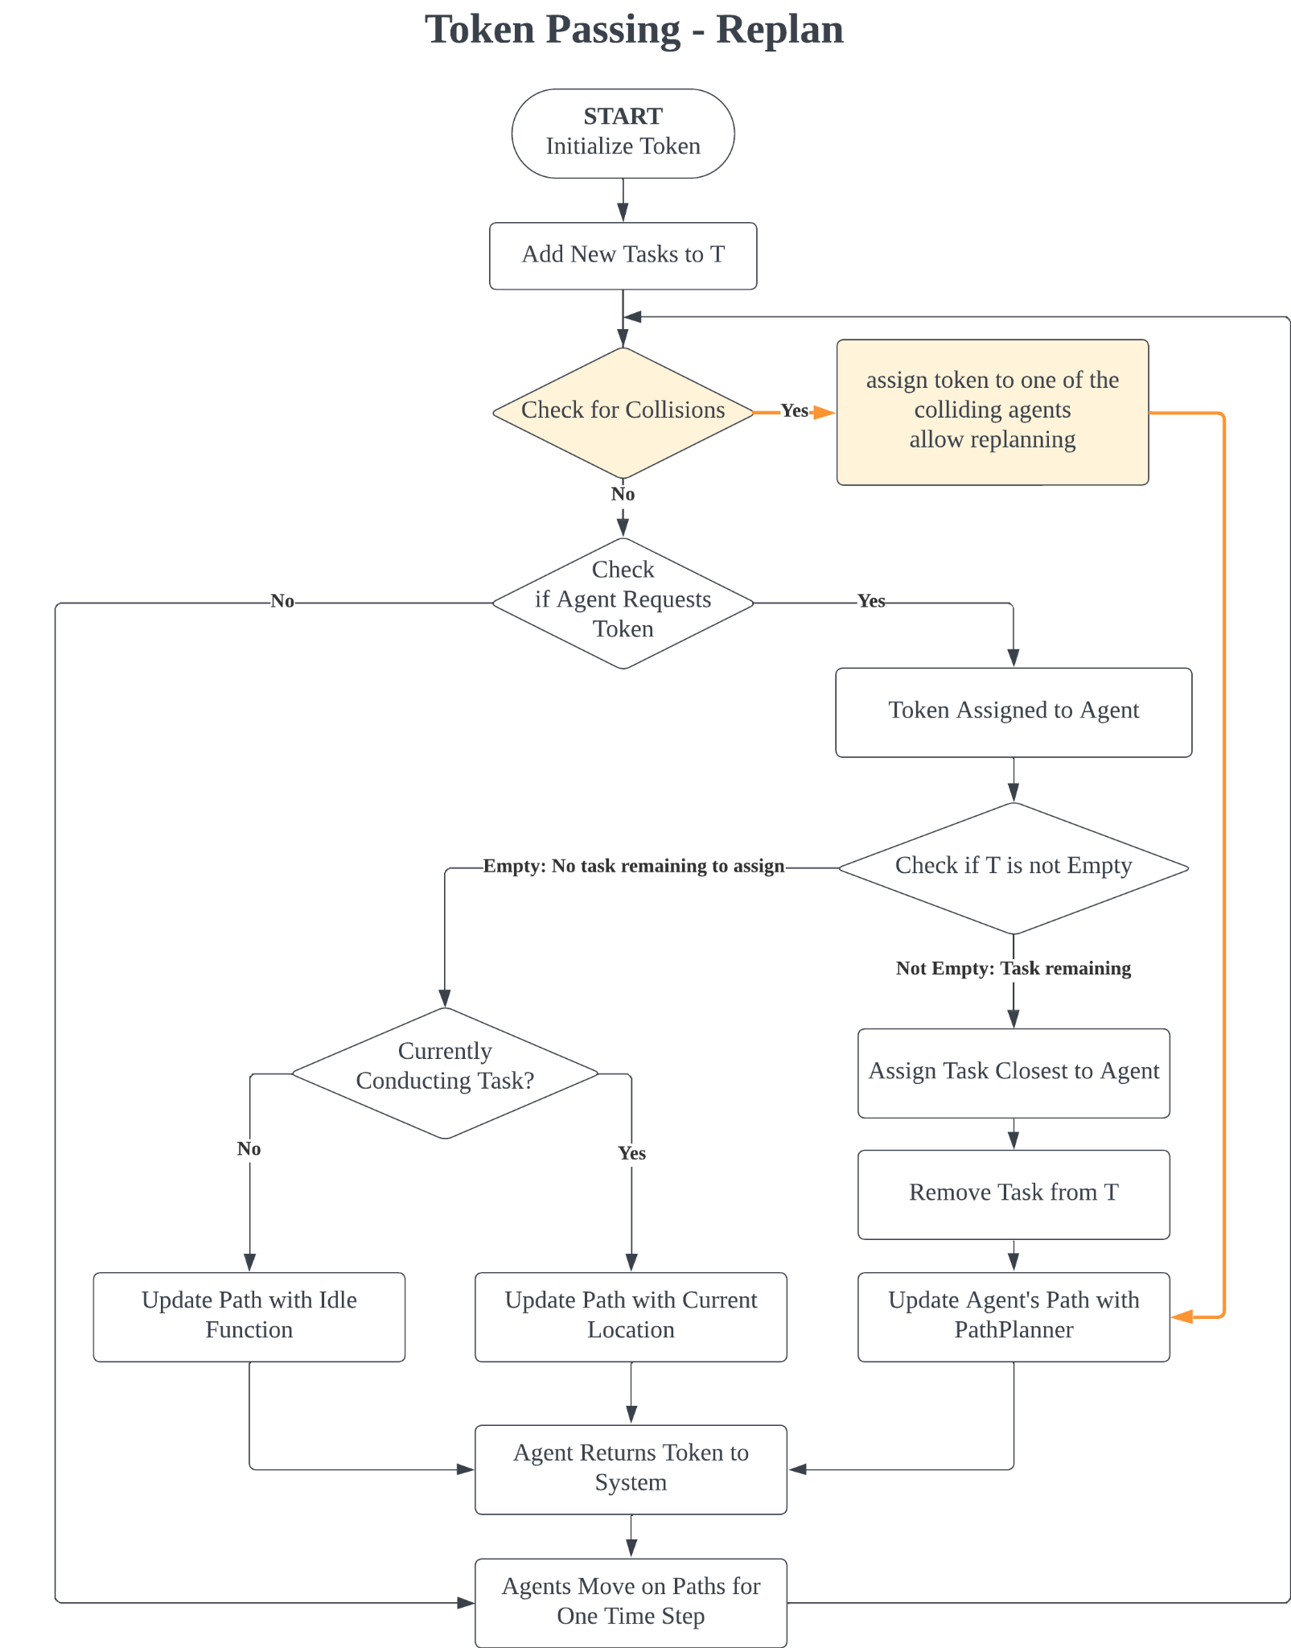
Algorithm 1 | Token Passing
Initialize Token & Add New Tasks information to the Token
Check for agents requesting tokens
Agent with Token
Identify tasks that are currently not being targeted by any agent.
Identify path that doesn't conflict with the paths of other agents.
If one or more tasks are available, assign, and plan paths
If all current tasks are occupied, agent updates current status/path to the token
Returns the token to the system so that it is available for other agents
Agents move for one time step
Notes:
The first algorithm is called token passing, where all agents passes a token that contains all the information for MAPF, MAPD tasks
We will be utilizing a more state-of-the-art algorithm by using a variation of this

Slide 10
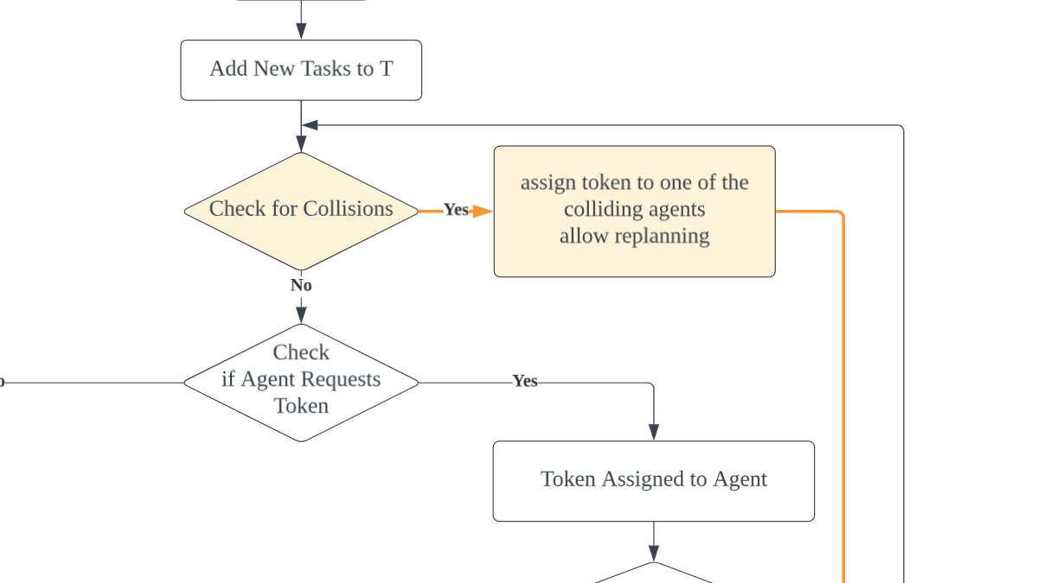
Algorithm 1 | Token Passing - Replanning
Checks for collisions
Immediately assign the token to the agent that has collision
Notes:
The basic is TP-replanning
the overall structure remains the same as token passing, but it added a feature where they check if there is any collision between agents
If there is any, tokens are assigned to them to solve the problem immediately

Slide 11
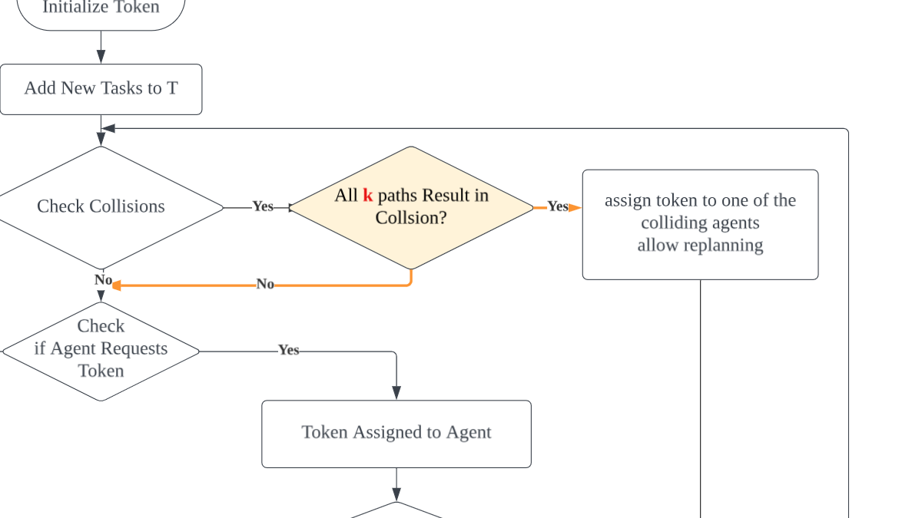
Algorithm 1 | K-TP
K-TP
Prepares for potential delays
Robustness Parameter (k): plans k number of paths allowing agents to handle up to 'k' consecutive delays without requiring immediate replanning
robust to interruptions → minimizing replanning → efficient
Notes:
KTP is adding a feature and a parmeter to TP replanning
This also checks collisions, however, it plans k number of paths ahead, so that agents don’t need to get the tokens immediately to solve the collision

Slide 12
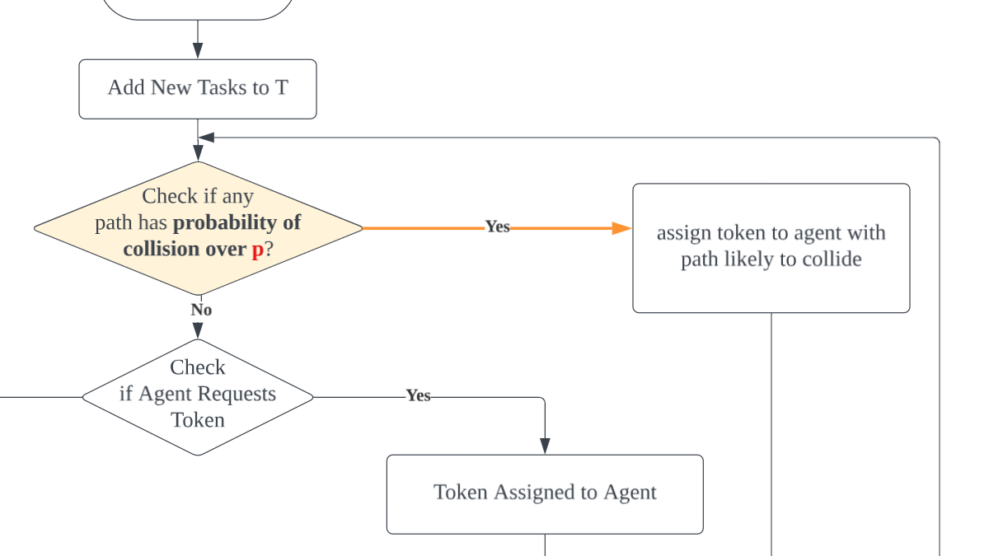
Algorithm 1 | P-TP
P-TP
Threshold Probability (p): computes paths considering the probability of delays and adjusts the paths if the likelihood of delay exceeds the threshold 'p'
Notes:
Last is ptp, which also is a parameter on tp replanning.
This makes agents to check collision even before it happens, if the probability of colliding is over the p value

Slide 13
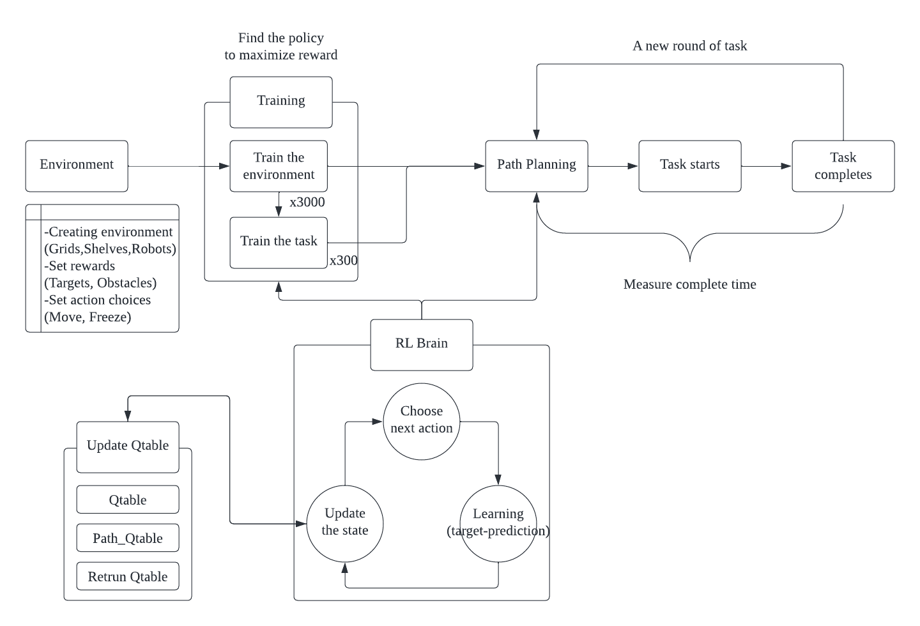
Algorithm 2 | RL
How does it work?
Notes:
I will explain about the RL architecture. The first part of setting involves building the environment. This involves creating a map, creating behaviors, and setting rewards. For the rewards, When they hit the obstacles, they will get -50. We also set the reward for the target that each robot has and the position to get back to its original position as +50,
Then there is the learning procedure. We can first train the environment with the Qtable and then train the task with the updated Qtable. The training goes through iterations with RL brain updating the Qtable. The results of this learning are reflected when updating the Qtable and choosing the next action. By repeating this process, we can train on the environment and tasks.
Finally, there is a test phase based on the trained results. We don't modify the Qtable from training, just update it with additional information about the given task to perform the task. If the environment changes significantly or the content of the task does not change significantly, you can proceed to TEST without training, but otherwise, you need to go back to the LEARNING phase to train again.

Slide 14
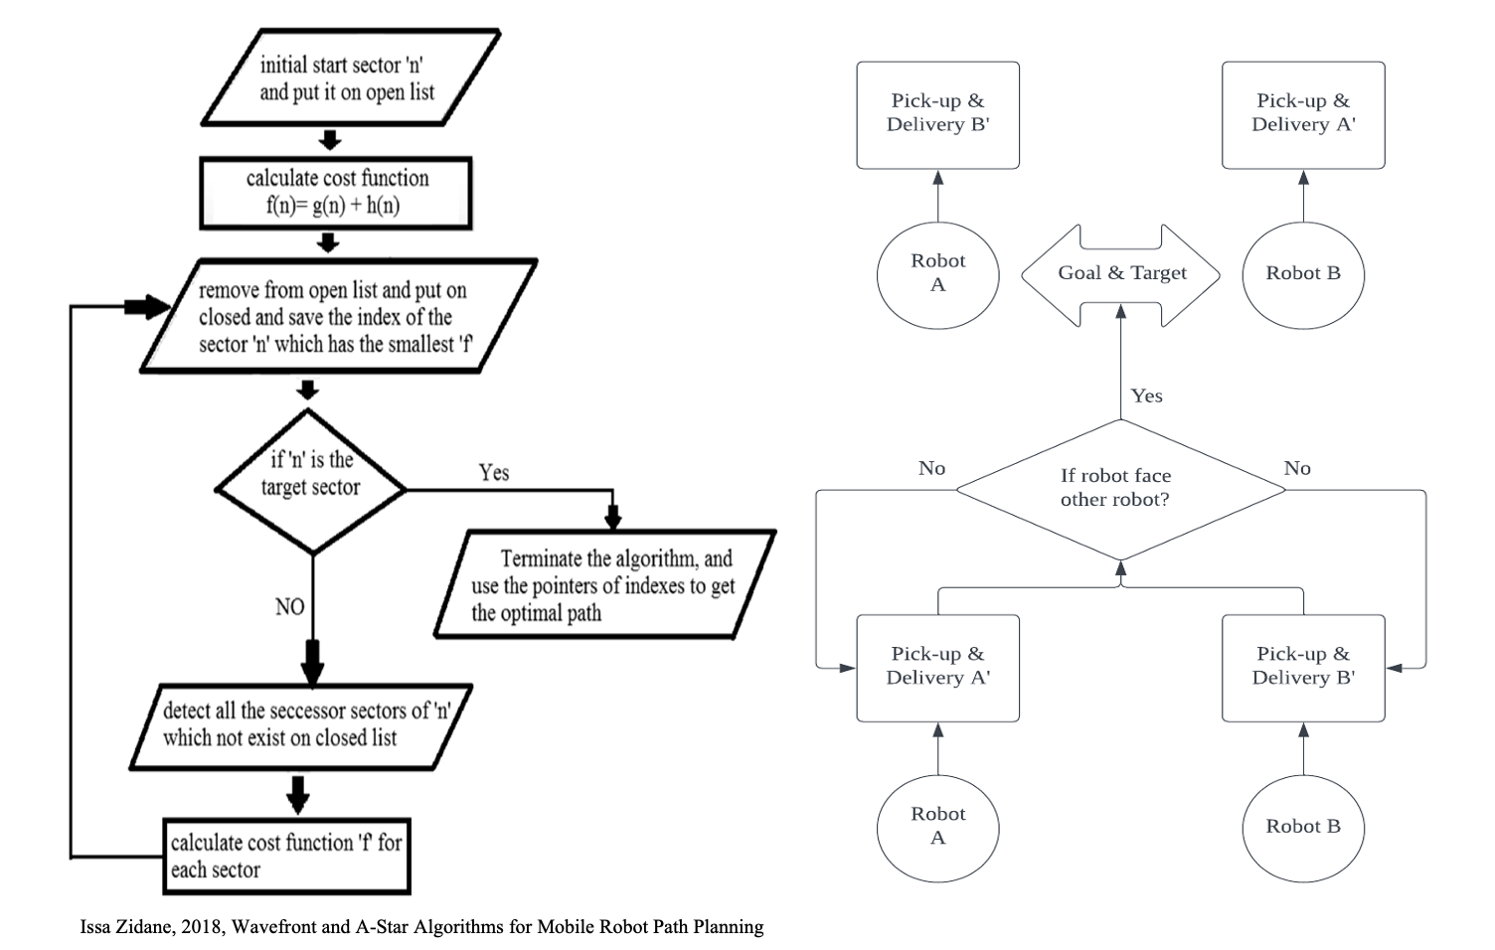
Algorithm 3 | Active Behaviour using A*
Find the most optimum path using A*
Exchange the goals if the robots collide with one another.

Slide 15
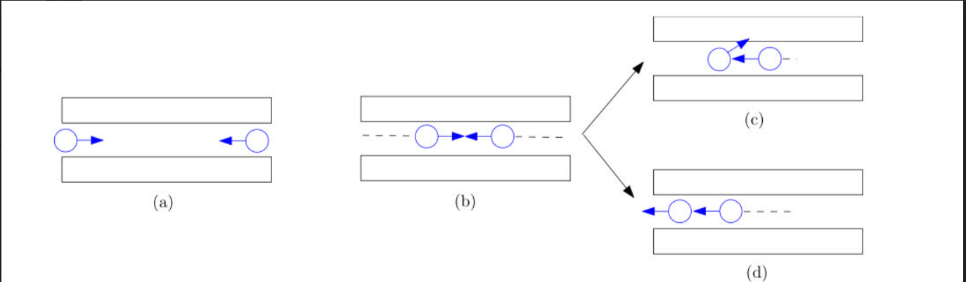
ALAN - Adaptive learning for Multi- Agent Navigation
Formulated multi-agent navigation problem in a multi-armed bandit setting
The reward value of each agent is learned through execution

Slide 16
Formal Design

Slide 17
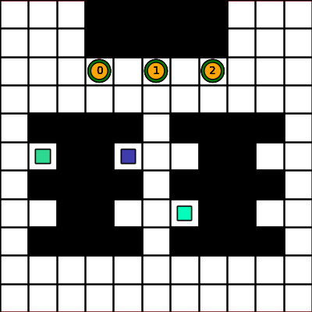
Formal Design | TP
Notes:
As mentioned in the previous section, all tp algorithms react differently to collisions.
Using the simulation on the grid above, i would like to explain the details of what is happening on each configuration when they plan their paths when they meet other agents

Slide 18
Formal Design | TP
t=9
2 delays
7 delays
6 delays
No delay
TP | KTP (k=2) | PTP (p=0.5)
Notes:
After nine steps
agents 0, 1, and 2 approach the yellow zone
TP-replanning algorithm simply keeps on going until they actually collide, so agent 1 simply waits some time stamp and follows agent 2 from the back
KTP however, the agent initially had 2 plans in its mind, so while agent 1 keeps on going, agent two goes with plan b. However in this case, the second path was to wait until agent 1 comes back, so it stays there for a while.
PTP, agents thought there was an over 50% possibility that collision will happen on that yellow zone, So agent 2 took a detour completely around the obstacle to reduce risk

Slide 19
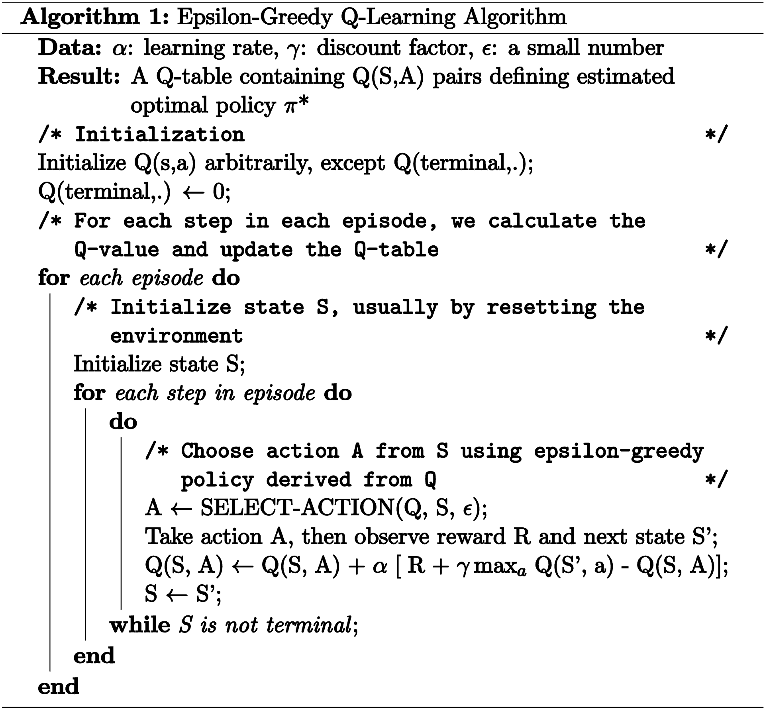
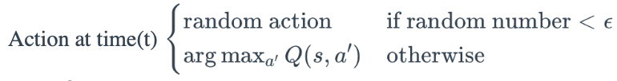
Formal Design| RL
How does it work?
Notes:
I will explain about formal design of RL. The main idea is to determine a policy that updates the Qtable and selects an action for the state based on the updated Qtable.
In general, there are two cases in Q-learning: greedy and ε-greedy (epsilon greedy). Here, we use ε-greedy to balance the desire to explore new paths with the desire to utilize previously learned information.
First, let's take a closer look at how we update the Qtable in each eqisode in pseudo code. Q of S A is the Q-value for taking action a in state s. α is the learning rate, R of s,a is the reward received, gamma is the discount rate, and maxa′​Q(s,a′) is the maximum possible Q-value in the next state. They update to maximize the Q value
Let’s look at the function on the right. Based on these updated values, the policy is determined by the following formula. Depending on epsilon, it first choose random action, but as learning proceed it choose action to maxmize Q value.

Slide 20
Formal Design | Active behaviour with A*
G2
R1
R2
G1
G2
R1
R2
G1

Slide 21
Implementation

Slide 22
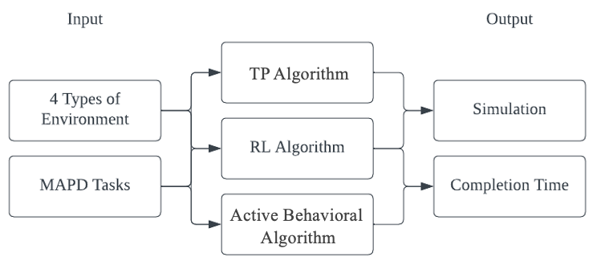
Implementation
Notes:
For our experiments, we created four environments and assigned the same multi-agent pick-up and delivery task to each environment. We prepared and tested the TP algorithm, reinforcement learning, and active adaptive algorithms to perform the task according to these conditions. This allowed us to visualize the work of each algorithm and measure its completion time.

Slide 23

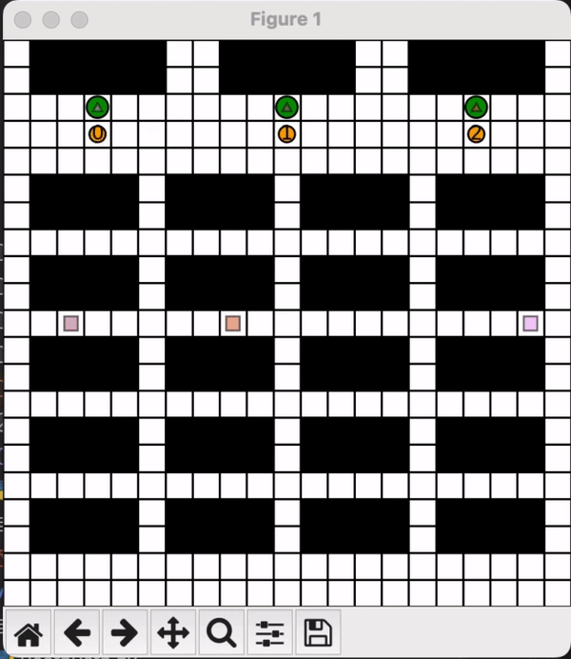
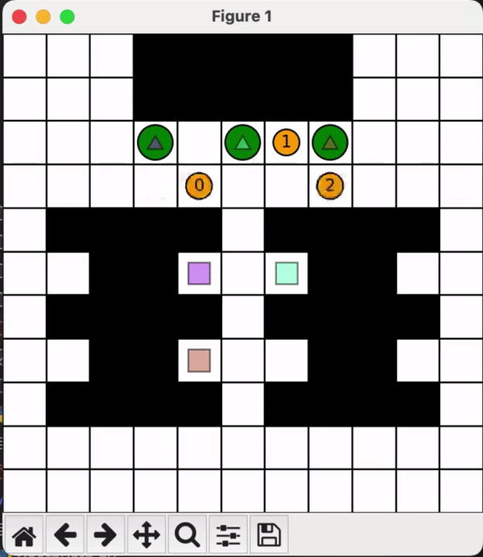
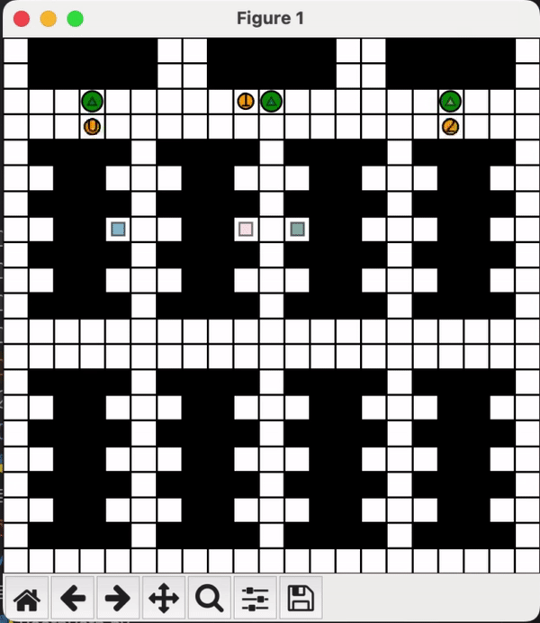
Implementation | TP
Notes:
After modifying the original code to our experimental setup, we tested original tp, and the parameters to find the optimal k and p values
We selected 1 and 2 for k values and 0.5 and 0.1 for p values after trials since there were limited impact after those thresholds.

Slide 24
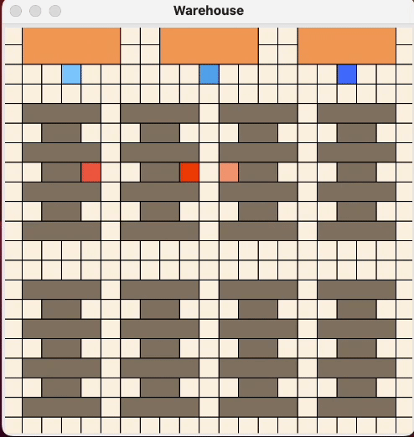
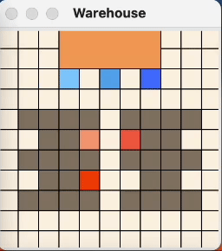
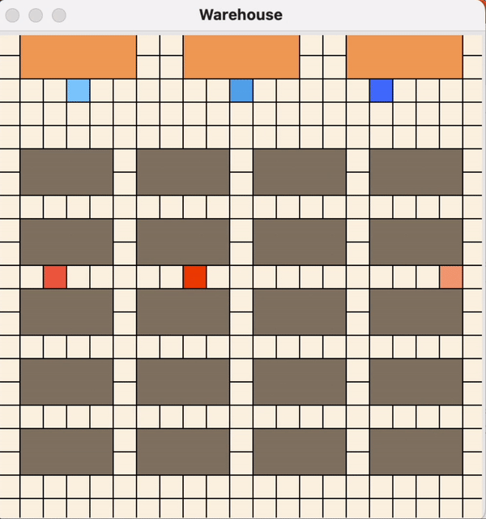
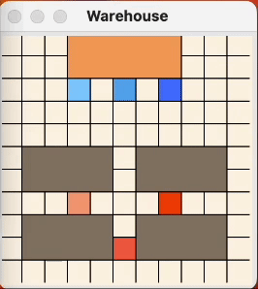
Implementation | RL
Notes:
The code consists of a total of 4 .py files and 12 qtable files. The robots records their path to the goal, path from the goal to their initial location, their combined path and qtable. New_small_maze.py is the file that configures the environment.
RLBrain.py is a code to implement reinforcement learning logic, Qtables.py is implemented so that the qtables can reflect updated information. Warehouse_test.py is the file that combines all three of the files into a simulation.

Slide 25
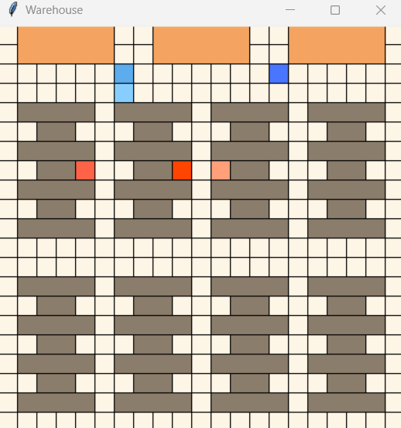
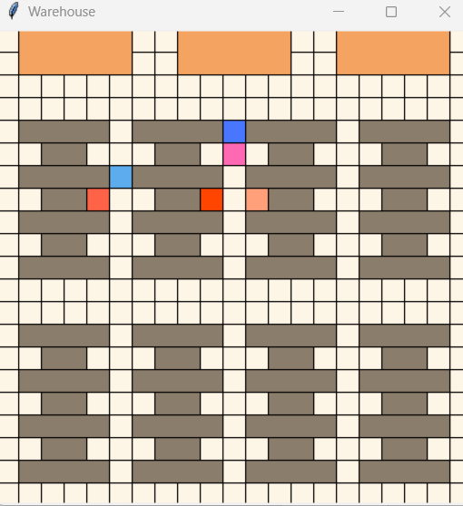
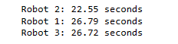
Implementation | Active behaviour A* Algorithm (LC)

Slide 26
Evaluation

Slide 27
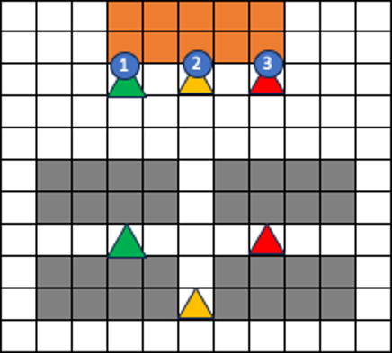
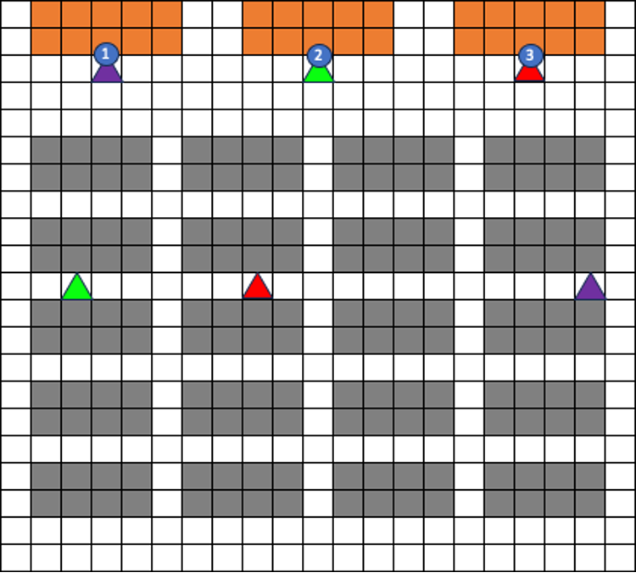
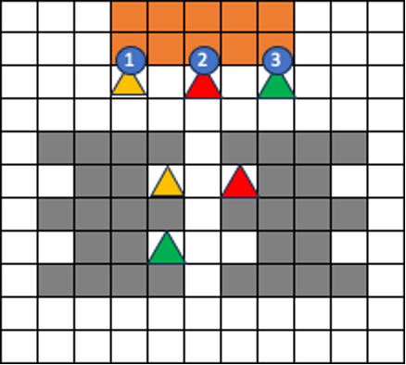
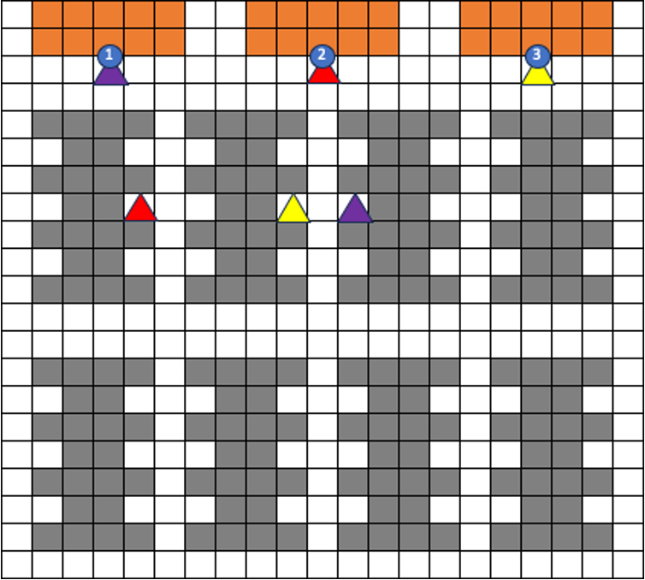
Environment
3 robots & 3 tasks (all target points assigned)
Differs by complexity & size
Measure completion time(implementation time only), and simulation
Notes:
We had 4 environments for our simulations differing in complexity and size.
three robots each had a designated task with a goal

Slide 28
Environment | simple
Simple warehouse structure, less complicated pathways, generally straight paths

Slide 29
Environment | complex
More complex warehouse environments, goals are located within the small areas

Slide 30
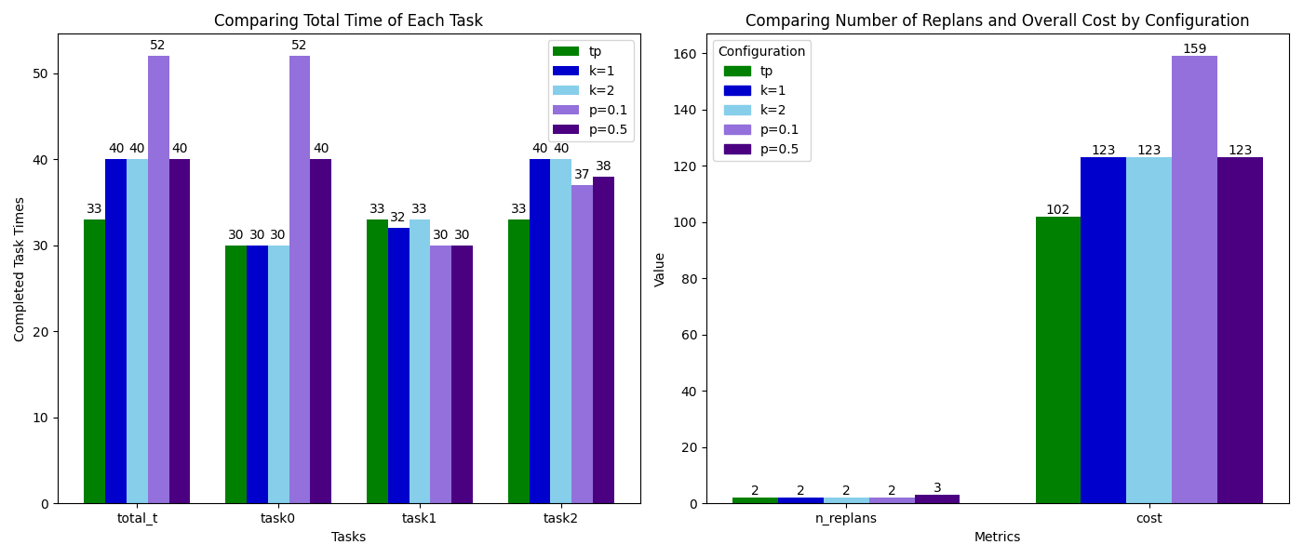
Evaluation | TP - Complex & Large
→ TP-replanning
Notes:
Since TP algorithms had 5 variations, we compared the total time, time taken for each tasks, number of replans, and the cost
Based on all these factors, we chose the optimal configuration that can be compared with the other algorithms.
In a complex large environment, TP-replanning with no other features worked best performing best in most factors

Slide 31
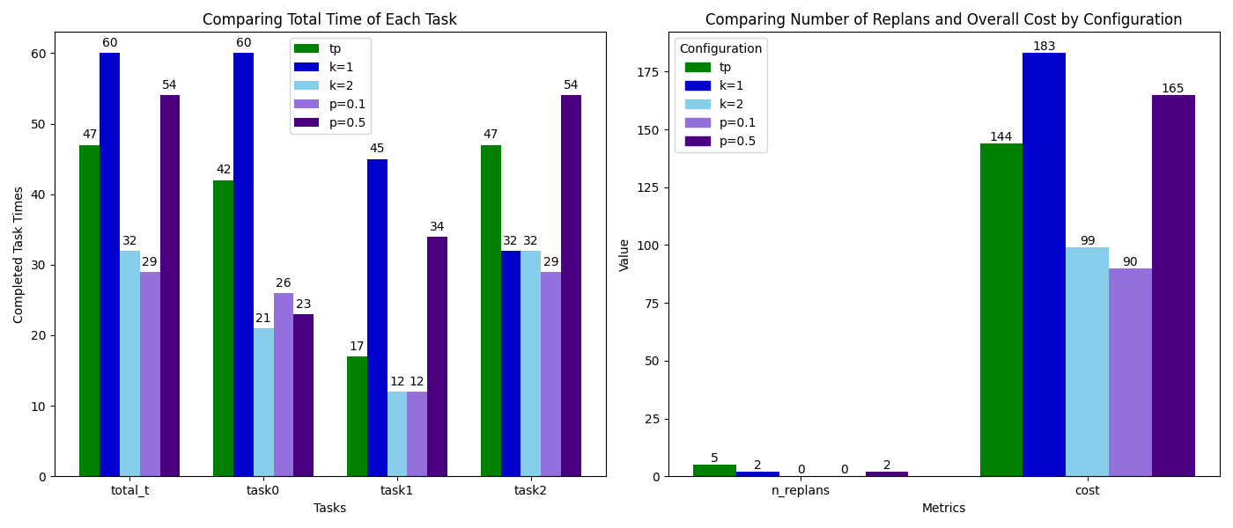
Evaluation | TP - Complex & Small
→ P-TP=0.1
Notes:
In a complex small environment, adding a p value of 0.1 outperformed the other configurations
K value of 2 also showed great performance, whereas tp-replanning with no parameters experienced 5 delays.
This states that the environment had multiple collisions, thus adding parameters helped

Slide 32
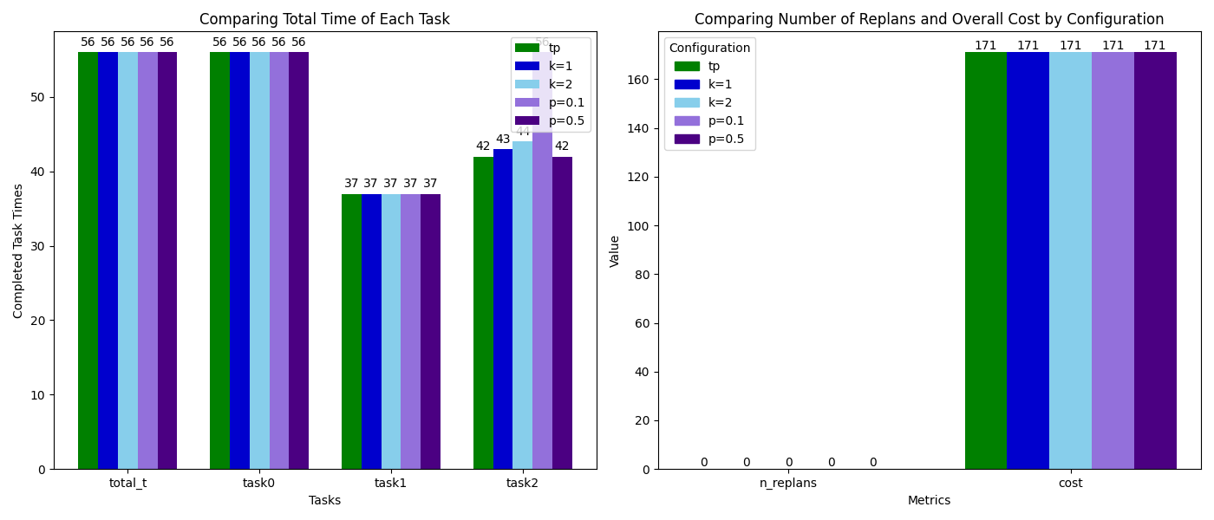
Evaluation | TP - Simple & Large
→ TP-replanning
Notes:
In a simple large environment, all configurations had similar results with no replanning, meaning the environment did not need extra tuning for collisions

Slide 33
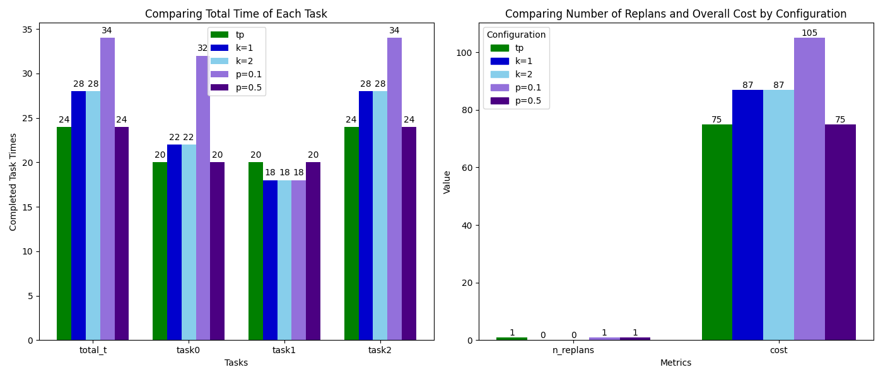
Evaluation | TP - Simple & Small
→ TP-replanning / P-TP=0.5
Notes:
In a simple small environment, tp-replanning and ptp of 0.5 had same results on all factors

Slide 34
Evaluation | RL
1.Measure completion time
2.Record the simulation
With a speed of 1 second per grid, it would take hundreds of training runs to measure, which would be not possible to take.
Instead, we used the simulation recordings to find the number of grids moved, and then waiting time and calculate the completion time..
Notes:
앞서 설명한

Slide 35
Active Behaviour using A*
Run the simulation such that the robot moves one block in the grid per second.
Check if they are colliding with each other.
Measure the Completion time

Slide 36
Results

Slide 37
Results
1.completion time
 | TP | Reinforcement Learning | A* algorithm with active behavior
Complex Large | 33 (tp) | 53 | 27
Complex Small | 29 (p=0.1) | 28 | 17
Simple Large | 56 (tp) | 94 | 15
Simple Small | 24 (tp) | 40 | 11
Except for the complex small environment, TP performed better than RL
A* algorithm with active behavior outperformed the others
RL used in this project was not suitable for MAPD task in complex environment and active behavior could make better performance.

Slide 38
Results
2.Simulation
Error behavior on RL : we could saw the training ended up as some robots hit the shelves and other robots
(there need to be tested and have feedback during or end of training.
A*star algorithm with active behavior still has a problem when it faces too crowded situation like bottle-neck.

Slide 39
Discussion & Conclusion

Slide 40
Discussion - Real World Application
An optimal multi-agent pickup and delivery solution for robots maximizes the efficiency of resource utilization which can reduce costs and increase productivity.
Reduced traffic congestion, improved delivery services, and greater scalability of autonomous systems
For this project to be useful it must be able to handle to scale up its computational complexity and applicability to dynamic environments
For all pathfinding algorithms, one of the key challenges is striking a balance between true optimality and performance (in this case total time)

Slide 41
Conclusion
This Study compares TP, RL, and A* based active algorithms in multiple environments, to find the optimal algorithm that works best for multiple path finding, pickup and delivery tasks.
Results showed that the A* based active algorithm outperformed TP and RL algorithms in small, complex environments, indicating a need for further studies in adaptive, active algorithm can highly improve robot usage in these complex environments.
Notes:
This Study compares three algorithms in multiple environments, to find the optimal algorithm
Results showed that the A* based active algorithm outperformed TP and RL algorithms in small, complex environments, indicating a need for more studies in adaptive, active algorithm with simultaneous interaction within robots

Slide 42
Thank you!

Slide 43
